Slide 1
Brain Tumor Detection From MRI
Using Deep CNN
Presented By
Khadija Binti Yasin
ID:18302016
Supervised by
Md. Sajjatul Islam
Assistant Professor
Dept. of Computer Science & Engineering(CSE)
School Of Science & Engineering(SSE)
Chittagong Independent University

Slide 2
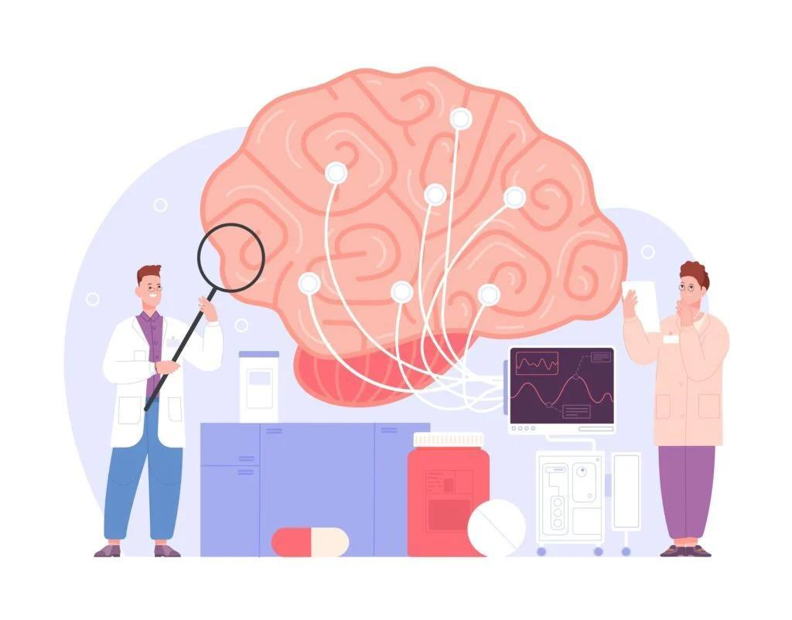
INTRODUCTION
In modern healthcare, the timely and accurate detection of brain tumors stands as a critical challenge.
Current diagnostic methods often lack precision, leading to delayed detection and treatment.
Addressing these limitations and developing more accurate detection techniques is imperative for enhancing the prognosis and quality of life for individuals affected by brain tumors.

Slide 3
MOTIVATION
Medical Significance Develop innovative tools and technologies that can assist healthcare professionals.
Global Health Brain tumor detection accessible and effective for all, addressing global improving healthcare equity.
Inspiring future generations of scientists to join the fight against brain tumors.

Slide 4
OBJECTIVE
To recognize brain tumor from MRI image using pre-trained CNN.
To evaluate the performance of the model on the MRI images.

Slide 5
LITERATURE REVIEW - 01
Paper Name | Methodology | Data | Finding & Limitation
Object Detection for Brain Cancer Detection and Localization. [2] | YOLO v8s, Stochastic gradient descent (SGD), Precision, recall, precision–recall curve, and average precision (AP). | 300 brain images | Achieved a precision of 0.943 and a recall of 0.923. The YOLO v8 model we adopted obtained values equal to 0.935 and 0.388, respectively.
MRI-based brain tumor detection using convolutional deep learning methods and chosen machine learning techniques [10] | Convolutional Neural Network (CNN) | 3264 Magnetic Resonance Imaging (MRI) brain images | Approximately 95% to 96%, and areas under the receiver operating characteristics curves (AUROC) are 0.99 or 1. This proposed network is less complex than the auto-encoder network

Slide 6
LITERATURE REVIEW - 02
Paper Name | Methodology | Data | Finding & Limitation
Brain Tumor Detection Using Convolutional Neural Network [2] | Support Vector Machine (SVM), K-Nearest Neighbor (KNN), Multilayer Perceptron (MLP), Logistic Regression, Naïve Bayes and Random Forest | MRI Brain image | 92.42% of accuracy using SVM and 97.87% of accuracy is achieved using CNN. The future work of 3D brain images, achieve more efficient brain tumor segmentation.
Explainable Convolutional Neural Networks for Brain Cancer Detection and Localisation [3] | VGG16, ResNet50, Alex_Net, and MobileNet models. | Br35H:Brain Tumor Detection 2020 | An accuracy ranging from 97.83% to 99.67% in brain cancer detection The detection of the cancer grade with improving the obtained performances

Slide 7
LITERATURE REVIEW - 03
Paper Name | Methodology | Data | Finding & Limitation
Brain Tumor Detection Based on Deep Learning Approaches and Magnetic Resonance Imaging [4] | YOLOv7 CNN | 2548 images of gliomas, 2658 images of pituitary, 2582 images of meningioma, and 2500 images of non-tumors | The trained model has achieved accuracy of 99.5% in our analysis. Various types of brain lesions, each with distinct characteristics, to help healthcare professionals address the complexities of real-world diagnostic challenges.
Multimodal brain tumor detection and classification using deep saliency map and improved dragonfly optimization algorithm [5] | CNN model, Efficient NetB0 | Br35H:Brain Tumor Detection 2020 | Accuracy of 95.14, 94.89, and 95.94% The detection and segmentation networks to avoid redundant processing and improve the generalization capabilities.

Slide 8
LITERATURE REVIEW - 04
Paper Name | Methodology | Data | Finding & Limitation
Fast brain tumor detection using adaptive stochastic gradient descent on shared-memory parallel environment [6] | SMP-SGD, SMP-Momentum, SMP-Adagrad, and SMP-Adam algorithms | MRI Brain image | It achieves a 93.4% accuracy. The proposed model will be tested for group engagement detections and evaluated group using the model as a future enhancement.
Vision Transformers, Ensemble Model, and Transfer Learning Leveraging Explainable AI for Brain Tumor Detection and Classification [7] | deep learning (DL) architectures including Visual Geometry Group 16 (VGG16), InceptionV3 | MRI Brain 3264 images | Accuracy of model 95.11% 93.88%,94.19%, 93.88% respectively. Furthermore Explainable AI to evaluate the performance and validity of each DL model.

Slide 9
LITERATURE REVIEW - 05
Paper Name | Methodology | Data | Finding & Limitation
Improved Multiclass Brain Tumor Detection using Convolutional Neural Networks and Magnetic Resonance Imaging [8] | Convolutional Neural Network. | Brain cancers (MRI) images | CNN networks reach 95% of recall, 95.44% accuracy and 95.36% of F1-score. Enhancing the robustness and precision of models involves the exploration of alternative methodologies and the utilization of substantially larger and more diverse datasets
Innovative brain tumor detection using optimized deep learning techniques [9] | Convolutional neural network (CNN),Accuracy, precision and recall parameters. | Brain cancers (MRI) images | Accuracy of this optimized system has been measured at 98.9%.

Slide 10

DATASET SUMMARY
The Dataset has been collected from an open-source platform, RoboFlow. So, we have used secondary source of data for our thesis.
The dataset has around 7292 images of brain MRI Scan Images.
The collection consists of 7292 annotation files.
These files state the exact position of the items (i.e., height, width, class and 4 values for each bounding box x-min, y-min, x-max, y-max) are recorded in text files.

Slide 11
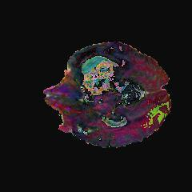
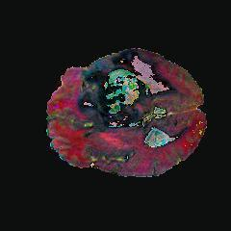
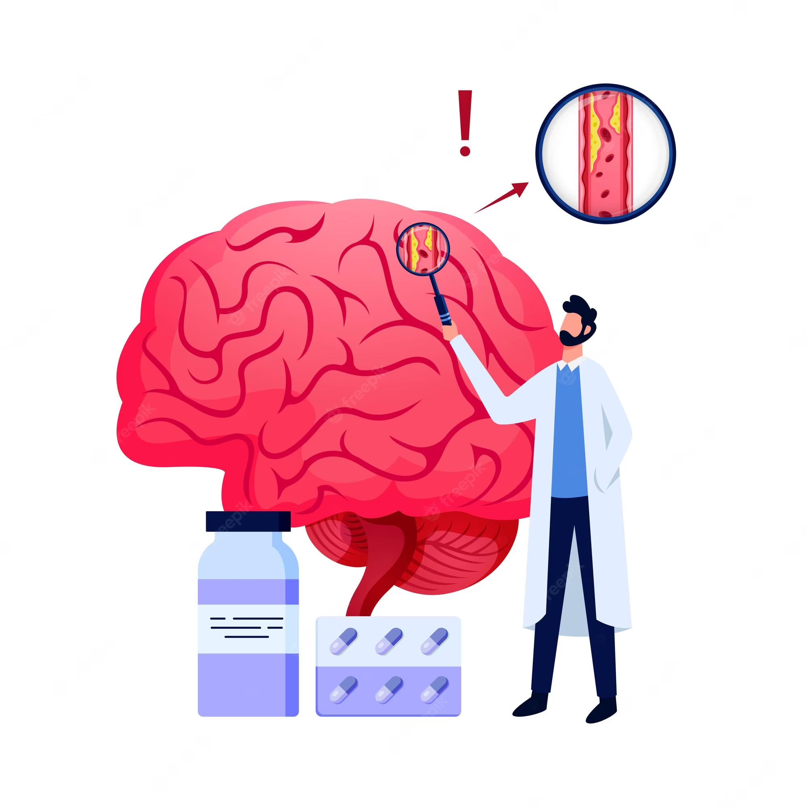
Review of Dataset Brain cancer MRIs
Problem in Dataset
Imbalance Problem
Sol: Data Augmentation
No Bounding Box
Contrast Variation
Fig: 1. The two MRI images belong to healthy brain, therefore, the model did not detect the tumor [1]

Slide 12
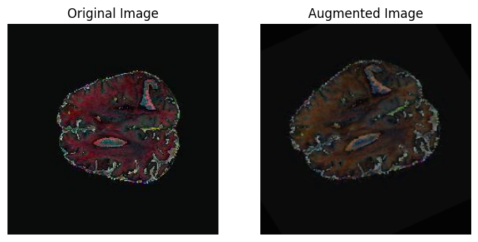
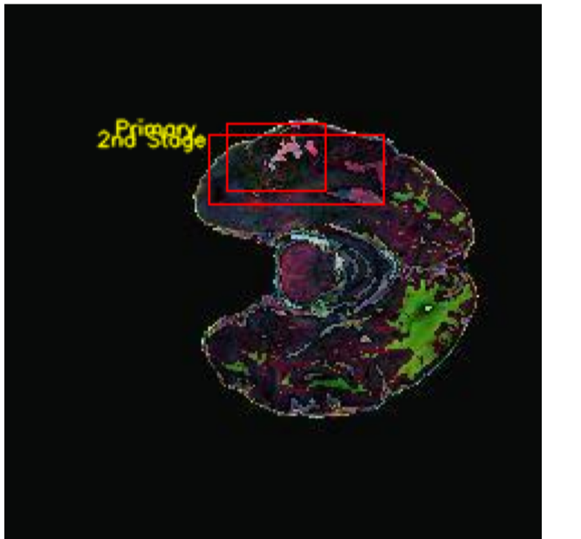
DATA PREPROCESSING
1
Bounding Box
DATA PRE-PROCESSING
2
Labeling
3
Image Augmentation
Fig: 2. The right image shows the original image, and bounding box, and the left image shows the labeling and Augmentation. [1]

Slide 13
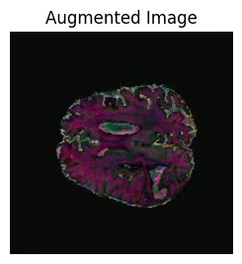
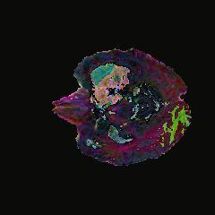

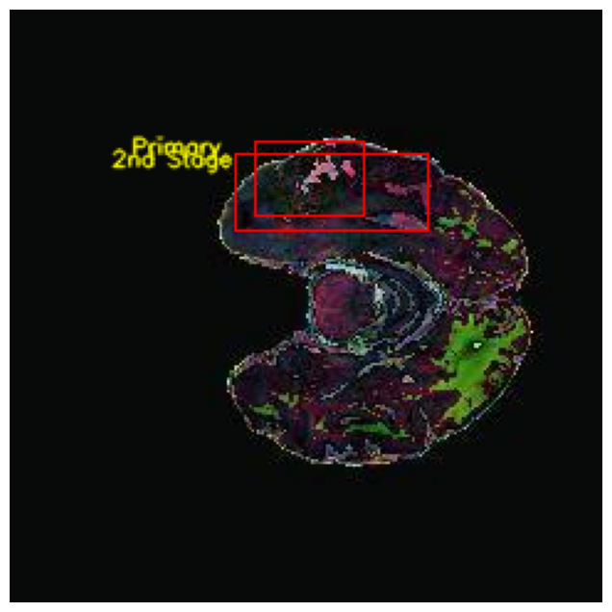
WORKFLOW DIAGRAM
Input Image
Data Augmentation
Image Pre-processing
Bounding Box
Labeling
Train
Built Model
(CNN, VGG_16, ResNet50)
Split DataSet
Test
Train Model With Data
Measure Performance With Test Data
Extract Model Accuracy

Slide 14
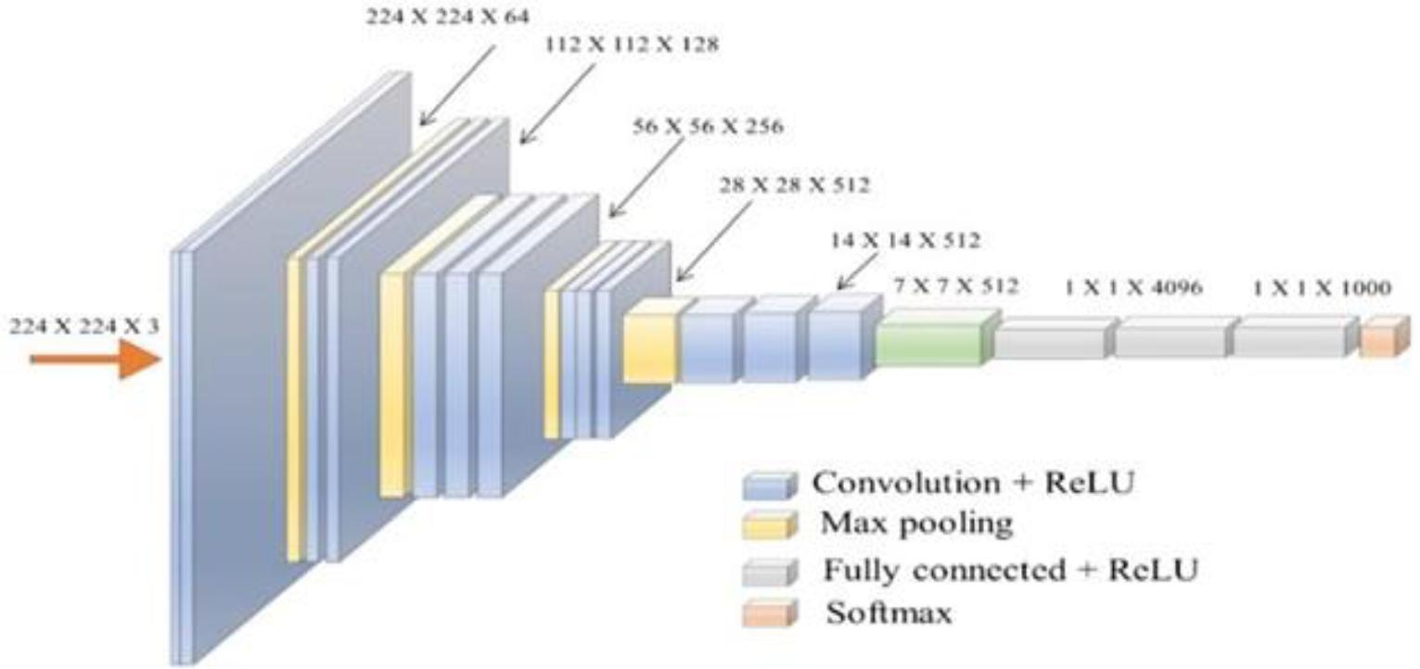
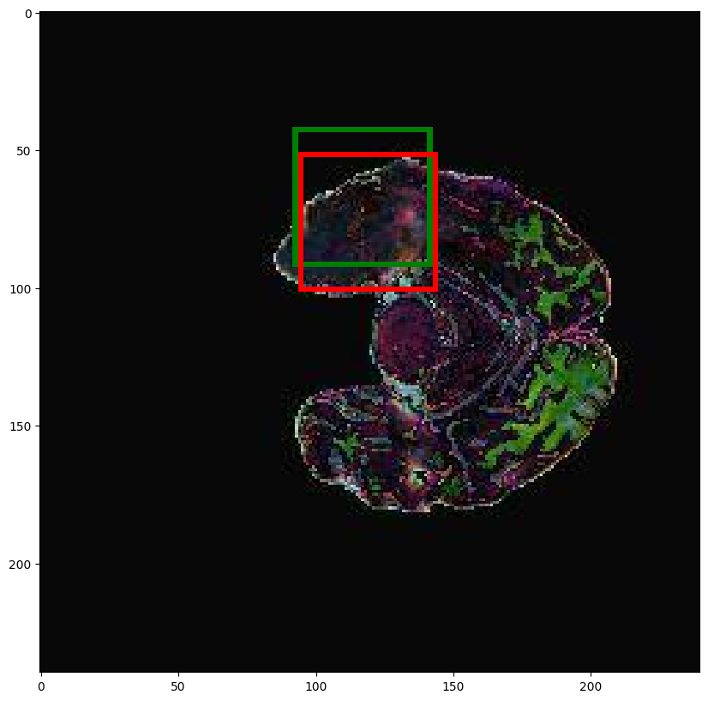
CNN Model Architecture
Input Image
Output Image

Slide 15
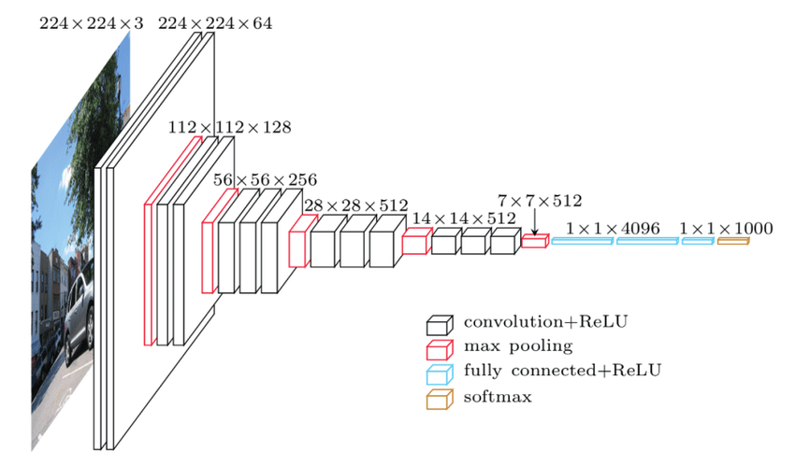
VGG_16 Model Architecture
Input Image
Output Image

Slide 16
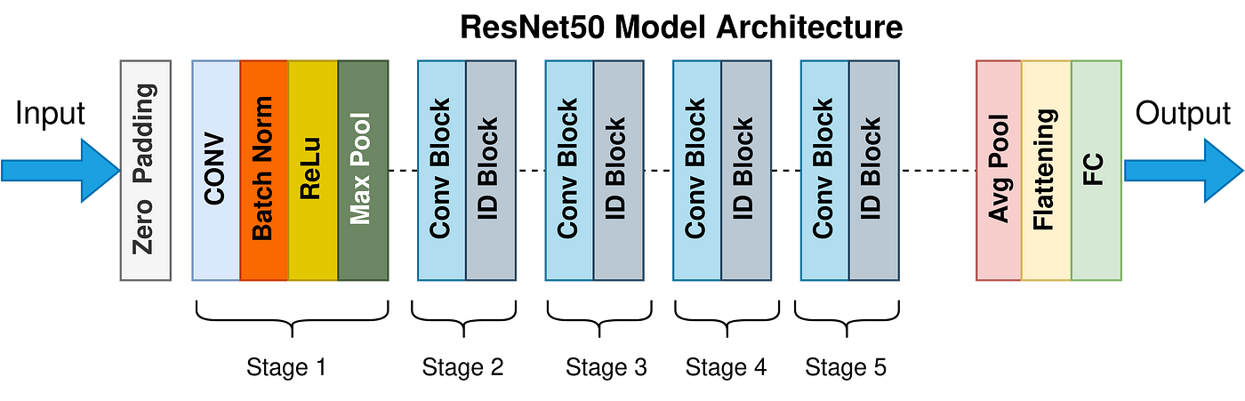
ResNet50 Model Architecture
Input Image
Output Image

Slide 17
EVALUATION PARAMETER
1
F1 SCORE
2
RECALL
3
PRECISION
4
ACCURACY

Slide 18
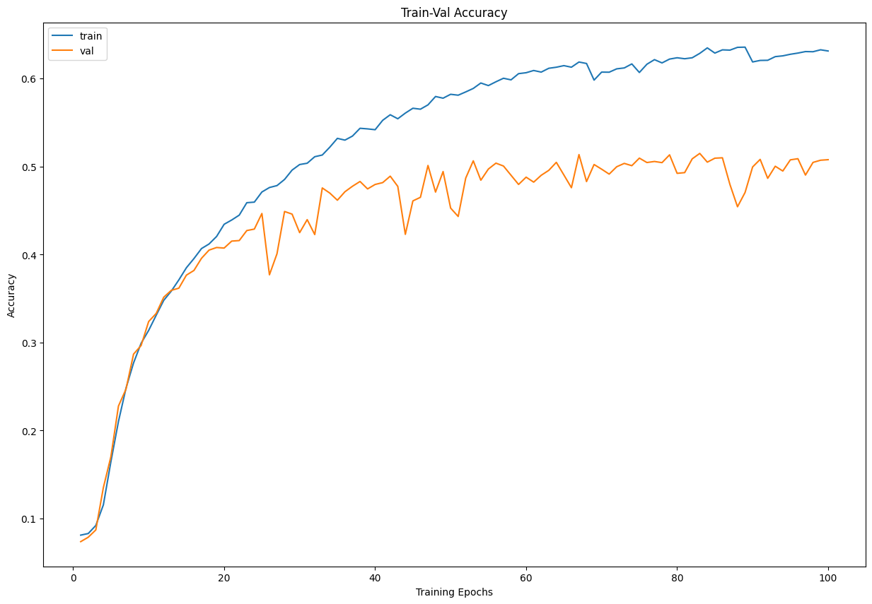
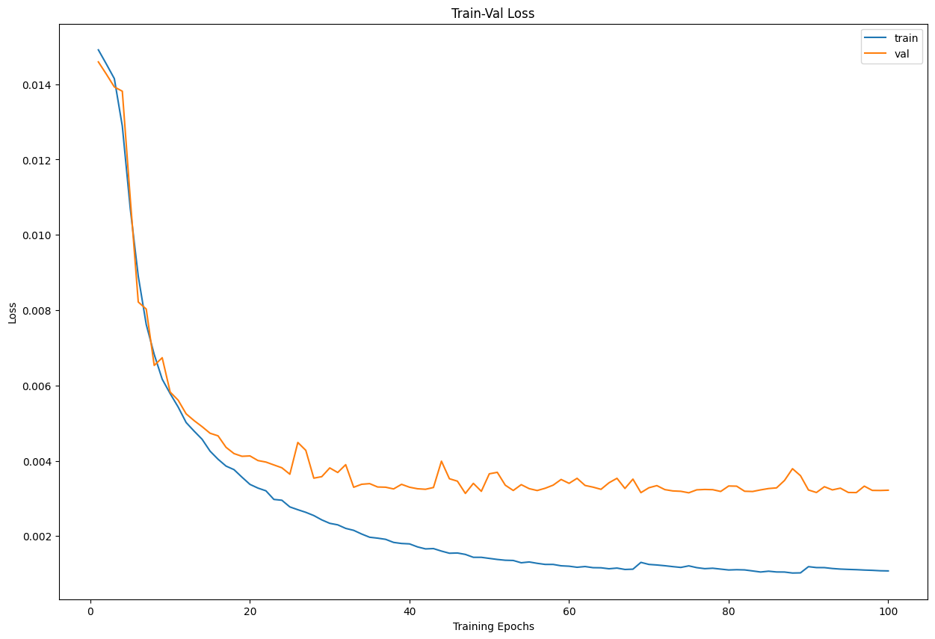
RESULT & ANALYSIS
a
b
Fig 3. Proposed model training and validation accuracy graph and comparison with CNN model.
The proposed model learns quickly and reaches to the acceptable accuracy of 72%.
The baseline method CNN flattens quickly and remains at 68% accuracy for even for the larger epochs.

Slide 19
RESULT & ANALYSIS
Model | Accuracy(%) | Precision(%) | Recall(%) | F1 Score(%)
CNN | 72 | 75 | 72 | 73
VGG_16 | 65 | 66 | 64 | 66
ResNet50 | 70 | 69 | 71 | 70

Slide 20
RESULT & ANALYSIS
CNN
Better Accuracy
Better F1 Score
Better Recall
Better Precision

Slide 21
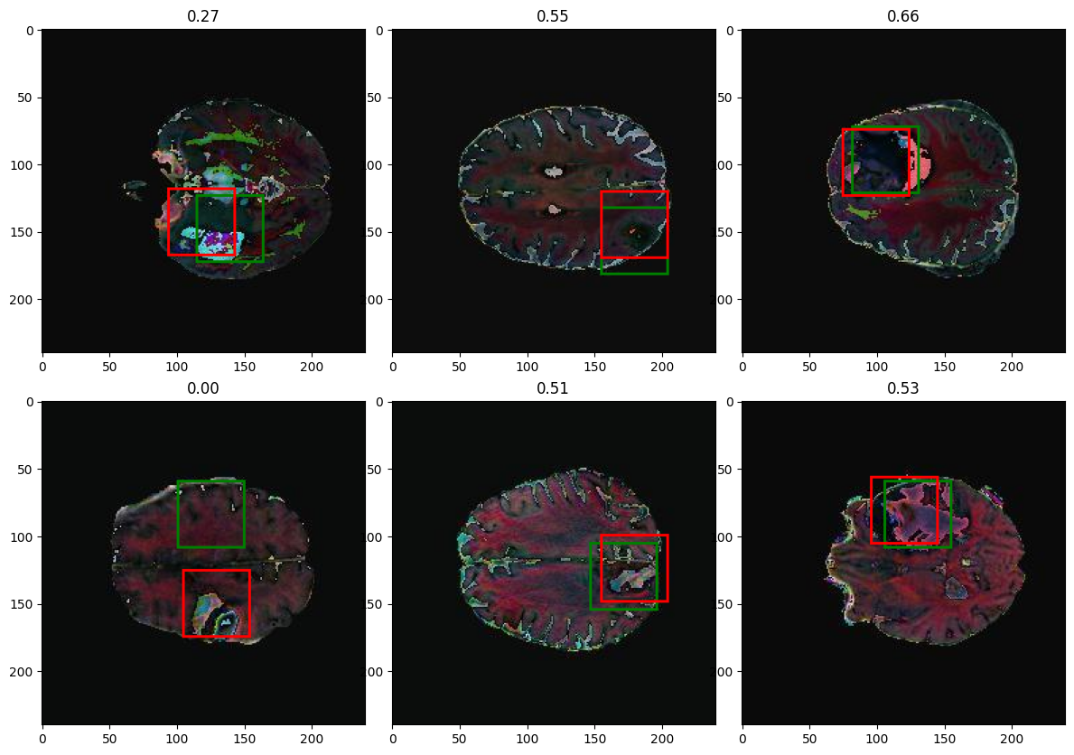
DETECTION RESULT
Fig 4. The rest of the images contains the tumor and the proposed method successfully detect the tumor and boxed it with green and red color. The proposed method also successfully detected the smallest infected region of the tumor.

Slide 22
LIMITATIONS
Limitations
Tumor detection in screening programs may not catch all cases, especially in the early stages when tumors are small and asymptomatic
Developing more accurate diagnostic tools, and advancing AI and machine learning techniques to assist healthcare professionals in tumor detection and diagnosis

Slide 23
REFERENCE
1.Brain MRI Images for Brain Tumor Detection. https://www.kaggle.com/navoneel/ brain-mri-images-for-brain-tumor-detection. Updated: 2019-01-07
2.Mercaldo F, Brunese L, Martinelli F, Santone A, Cesarelli M. Object Detection for Brain Cancer Detection and Localization. Applied Sciences. 2023 Aug 11;13(16):9158.
3.Hossain T, Shishir FS, Ashraf M, Al Nasim MA, Shah FM. Brain tumor detection using convolutional neural network. In2019 1st international conference on advances in science, engineering and robotics technology (ICASERT) 2019 May 3 (pp. 1-6). IEEE.
4.Mercaldo F, Brunese L, Martinelli F, Santone A, Cesarelli M. Explainable Convolutional Neural Networks for Brain Cancer Detection and Localisation. Sensors. 2023 Sep 2;23(17):7614.
5.Abdusalomov AB, Mukhiddinov M, Whangbo TK. Brain Tumor Detection Based on Deep Learning Approaches and Magnetic Resonance Imaging. Cancers. 2023 Aug 18;15(16):4172.
6.Khan MA, Khan A, Alhaisoni M, Alqahtani A, Alsubai S, Alharbi M, Malik NA, Damaševičius R. Multimodal brain tumor detection and classification using deep saliency map and improved dragonfly optimization algorithm. International Journal of Imaging Systems and Technology. 2023 Mar;33(2):572-87.
7.Qin C, Li B, Han B. Fast brain tumor detection using adaptive stochastic gradient descent on shared-memory parallel environment. Engineering Applications of Artificial Intelligence. 2023 Apr 1;120:105816.

Slide 24
REFERENCE
8.Hossain S, Chakrabarty A, Gadekallu TR, Alazab M, Piran MJ. Vision transformers, ensemble model, and transfer learning leveraging explainable ai for brain tumor detection and classification. IEEE Journal of Biomedical and Health Informatics. 2023 Apr 12.
9.Mahjoubi MA, Hamida S, El Gannour O, Cherradi B, El Abbassi A, Raihani A. Improved Multiclass Brain Tumor Detection using Convolutional Neural Networks and Magnetic Resonance Imaging. International Journal of Advanced Computer Science and Applications. 2023;14(3).
10.Ramtekkar PK, Pandey A, Pawar MK. Innovative brain tumor detection using optimized deep learning techniques. International Journal of System Assurance Engineering and Management. 2023 Feb;14(1):459-73.
11.Saeedi S, Rezayi S, Keshavarz H, R Niakan Kalhori S. MRI-based brain tumor detection using convolutional deep learning methods and chosen machine learning techniques. BMC Medical Informatics and Decision Making. 2023 Dec;23(1):1-7.

Slide 25


